Slide 1
Airline Flight Status Analysis

Slide 2
CONTENTS OF THIS Presentation
There’s what you’ll find in this presentation:
Introduction.
Dataset Overview.
Airline Dashboard Content.
Flight Status Analysis.
Age Analysis.
Flight Status Per Month.
Number of Passengers by Continent.
Conclusions and Insights.

Slide 3
Introduction
This project explores the dataset related to airline flight statuses, focusing on analyzing patterns, delays, and performance metrics across various airlines. By visualizing these key indicators in Power BI, we aim to offer insights into operational efficiencies and areas of improvement within the airline industry.

Slide 4
Dataset Overview
The dataset used in this analysis contains information about airline flights, including flight numbers, departure times, arrival times, delays, cancellations, and airline carriers. This section covers a comprehensive description of the data points included and their relevance in understanding flight operations.

Slide 5


Slide 6
Flight Status Analysis
The Number of Total Flights is 99,000 flights.
The Number of On Time Flights is 33K flights
The Number of Delayed Flights is 33K flights
The Number of cancelled Flights is 33K flights

Slide 7

Age Analysis
Average Age is 45.50 years.
This Pie Chart is Description of Passenger Age
Group.
Shows the percentage of passengers
in each age group.

Slide 8
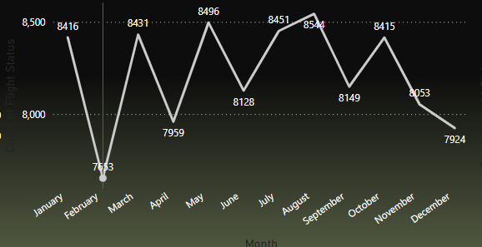
Flight Status Per Month
This Line Chart Show the number of flights for each month in the year.

Slide 9
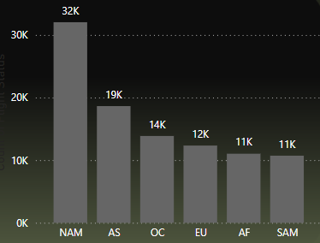
Number of Passengers by Continent
This chart presents the number of passengers in each continent, with a breakdown of the number of passengers in each major airport.

Slide 10
Conclusions and Insights
The analysis of airline flight statuses shows key trends that can help improve operations. Weather and peak travel times are major factors in delays, with some airlines performing better in on-time arrivals. Cancellations, though rare, often result from operational issues or weather. By identifying these patterns, airlines can improve scheduling, resource allocation, and communication during disruptions. Predictive models could also help anticipate delays and cancellations, reducing passenger inconvenience. Overall, data-driven decisions are essential for increasing efficiency and customer satisfaction in the airline industry.

Slide 11
Do you have any questions? Osama Mohamed | LinkedIn
Thanks!

